Slide 1
Software testing
Introduction:-
Testing is a process of executing a program with the aim of finding error. To make our software perform well it should be error free.If testing is done successfully it will remove all the errors from the software.

Slide 2
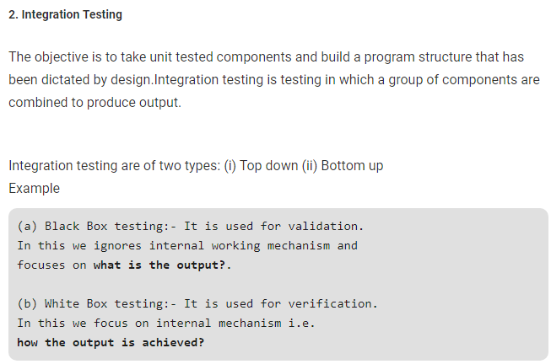

Slide 3
Principles of Testing:-
(i) All the test should meet the customer requirements (ii) To make our software ,testing should be performed by third party (iii) Exhaustive testing is not possible. As we need the optimal amount of testing based on the risk assessment of the application. (iv) All the test to be conducted should be planned before implementing it. (v) It follows parento rule(80/20 rule) which states that 80% of errors comes from 20% of program components. (vi) Start testing with small parts and extend it to large parts.

Slide 4
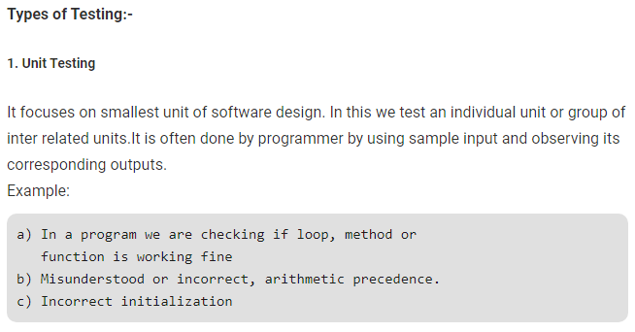

Slide 6
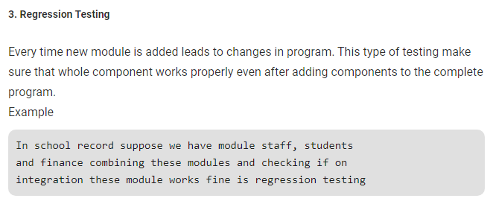

Slide 7
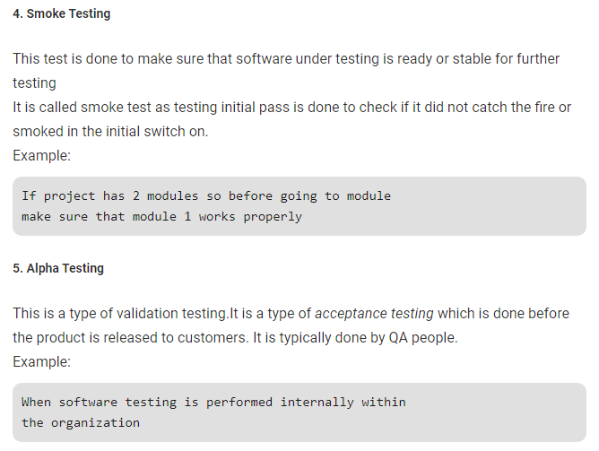

Slide 8
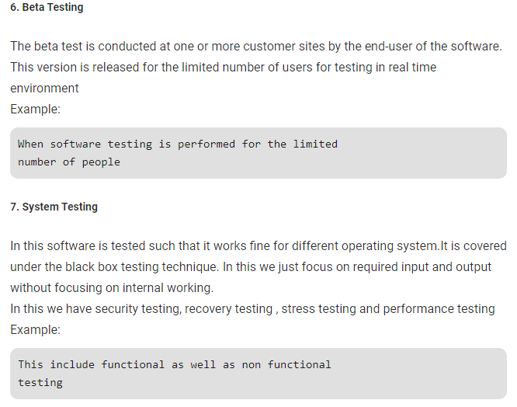

Slide 9
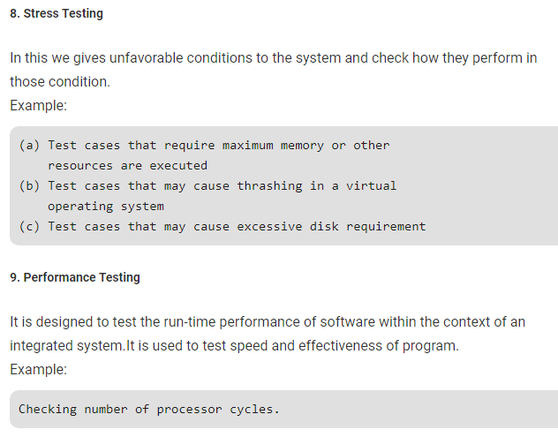

Slide 10
Security testing

Slide 11
What is Security Testing?
Security Testing is defined as a type of Software Testing that ensures software systems and applications are free from any vulnerabilities, threats, risks that may cause a big loss.
Security testing of any system is about finding all possible loopholes and weaknesses of the system which might result into a loss of information, revenue, repute at the hands of the employees or outsiders of the Organization.
The goal of security testing is to identify the threats in the system and measure its potential vulnerabilities, so the system does not stop functioning or is exploited. It also helps in detecting all possible security risks in the system and help developers in fixing these problems through coding.

Slide 12
Types of Security Testing:
There are seven main types of security testing as per Open Source Security Testing methodology manual. They are explained as follows:

Slide 13
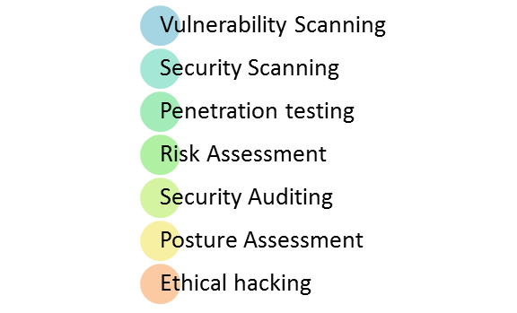

Slide 14
Vulnerability Scanning: This is done through automated software to scan a system against known vulnerability signatures.
Security Scanning: It involves identifying network and system weaknesses, and later provides solutions for reducing these risks. This scanning can be performed for both Manual and Automated scanning.
Penetration testing: This kind of testing simulates an attack from a malicious hacker. This testing involves analysis of a particular system to check for potential vulnerabilities to an external hacking attempt.
Risk Assessment: This testing involves analysis of security risks observed in the organization. Risks are classified as Low, Medium and High. This testing recommends controls and measures to reduce the risk.
Security Auditing: This is an internal inspection of Applications and Operating systems for security flaws. An audit can also be done via line by line inspection of code
Ethical hacking: It's hacking an Organization Software systems. Unlike malicious hackers, who steal for their own gains, the intent is to expose security flaws in the system.
Posture Assessment: This combines Security scanning, Ethical Hacking and Risk Assessments to show an overall security posture of an organization.

Slide 15
How to do Security Testing
It is always agreed, that cost will be more if we postpone security testing after software implementation phase or after deployment. So, it is necessary to involve security testing in the SDLC life cycle in the earlier phases.
Let's look into the corresponding Security processes to be adopted for every phase in SDLC

Slide 16
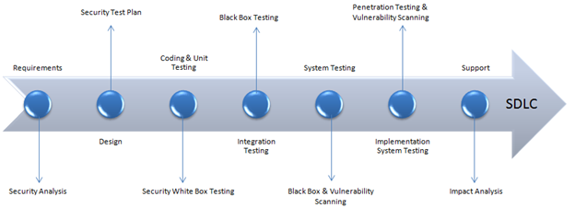

Slide 17
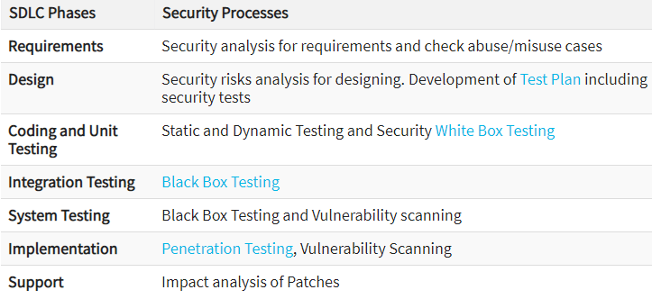

Slide 18
The test plan should include
Security-related test cases or scenarios
Test Data related to security testing
Test Tools required for security testing
Analysis of various tests outputs from different security tools

Slide 19
Example Test Scenarios for Security Testing:
Sample Test scenarios to give you a glimpse of security test cases -
A password should be in encrypted format
Application or System should not allow invalid users
Check cookies and session time for application
For financial sites, the Browser back button should not work.

Slide 20
Methodologies/ Approach / Techniques for Security Testing
In security testing, different methodologies are followed, and they are as follows:
Tiger Box: This hacking is usually done on a laptop which has a collection of OSs and hacking tools. This testing helps penetration testers and security testers to conduct vulnerabilities assessment and attacks.
Black Box: Tester is authorized to do testing on everything about the network topology and the technology.
Grey Box: Partial information is given to the tester about the system, and it is a hybrid of white and black box models.

Slide 21
Roles:
Hackers - Access computer system or network without authorization
Crackers - Break into the systems to steal or destroy data
Ethical Hacker - Performs most of the breaking activities but with permission from the owner
Script Kiddies or packet monkeys - Inexperienced Hackers with programming language skill

Slide 22
Conclusion:
Security testing is the most important testing for an application and checks whether confidential data stays confidential.
In this type of testing, tester plays a role of the attacker and play around the system to find security-related bugs.
Security Testing is very important in Software Engineering to protect data by all means.

